Slide 1

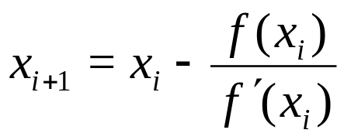
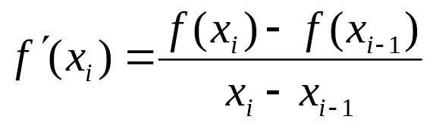
The Newton-Raphson method of solving a nonlinear equation f(x)=0 is given by the iterative formula
One of the drawbacks of the Newton-Raphson method is that you have to evaluate the derivative of the function.
It can be a laborious process, and even intractable if the function is derived as part of a numerical scheme.
To overcome these drawbacks, the derivative of the function, is approximated as
(1)
(2)

Slide 2

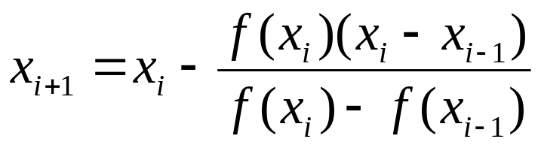
Substituting Equation (2) in Equation (1) gives
The above equation is called the secant method.
This method now requires two initial guesses, but unlike the bisection method, the two initial guesses do not need to bracket the root of the equation.
The secant method is an open method and may or may not converge.
However, when secant method converges, it will typically converge faster than the bisection method.
However, since the derivative is approximated as given by Equation (2), it typically converges slower than the Newton-Raphson method.
(3)

Slide 3

f (x)
f (x_{i})
B
f (x_{i–1})
C
E
D
A
x
x_{i+1}
x_{i–1}
x_{i}

Slide 4
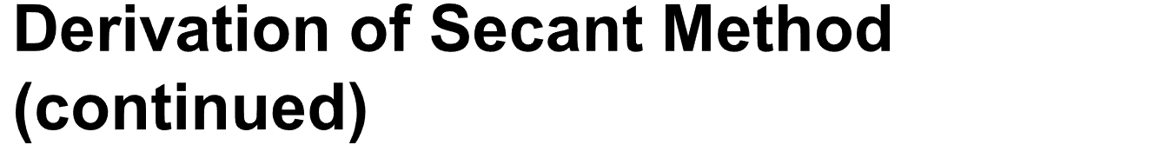
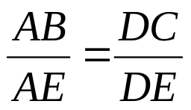
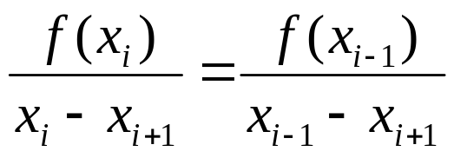

The secant method can also be derived from geometry, as shown in Figure 1. Taking two initial guesses, and , one draws a straight line between and passing through the x-axis at x_{i}. ABE and DCE are similar triangles.
Hence
On rearranging, the secant method is given as

Slide 5

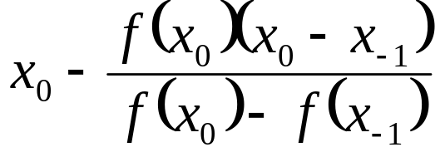
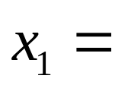
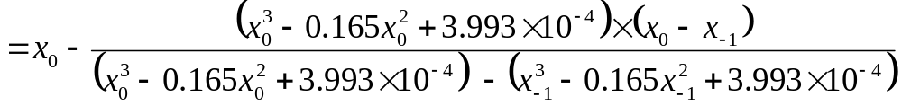
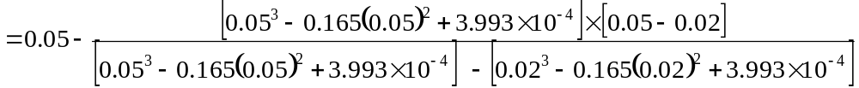

Let us assume the initial guesses of the root of f(x)=0 as x_{_1}=0.02 and x₀=0.05

Slide 6
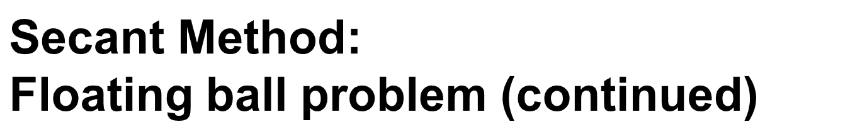

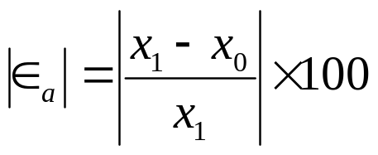

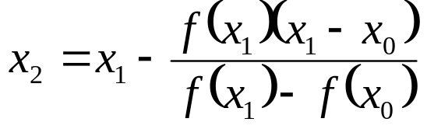

The absolute relative approximate error at the end of Iteration 1 is
As you need an absolute relative approximate error of 5% or less so you need more iteration to carry on.
Iteration 2
The absolute relative approximate error at the end of Iteration 2 is 3.525%
.

Slide 7
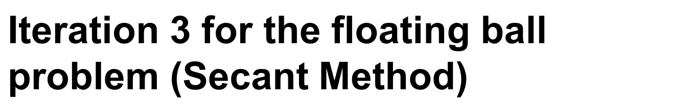
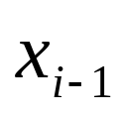

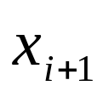


X₃ = 0.06238
The absolute relative approximate error at the end of Iteration 3 is 0.0595%
Table 1 shows the secant method calculations for the results from the above problem.
Table 1: Secent Method Result as Function of Iteration
Iteration Number, I
1 2 3 4 | 0.02 0.05 0.06461 0.06241 | 0.05 0.06461 0.06241 0.06238 | 0.06461 0.06241 0.06238 0.06238 | 22.62 3.525 0.0595 | -1.9812X10⁻⁵ -3.2852X10⁻⁷ 2.0252X10⁻⁹ -1.8576X10⁻¹³

Slide 8
Start
Define the function, f(x)
E_{a} = |(x_{i+1}-x_{i})*100/x_{i}|
Read x_{i-1} and x_{i}
A
x_{i} = x_{i+1}
Read E_{limit} & max_iteration
<
Print Count, x_{i+1} & E_{a}
E_{a} : E_{limit}
>
_{Iteration_count++}
iteration_count=0
Stop
Iteration_count : max_iteration
>
No convergence
<
Prof. S. M. Lutful Kabir, BRAC University

Slide 9
Advantages of Secant Method
It converges at faster than a linear rate, so that it is more rapidly convergent than the bisection method.
It does not require use of the derivative of the function, something that is not available in a number of applications.
It requires only one function evaluation per iteration, as compared with Newton’s method which requires two.

Slide 10
Disadvantages of Secant Method
It may not converge.
There is no guaranteed error bound for the computed iterates.
It is likely to have difficulty if f’(α) = 0. This means the x-axis is tangent to the graph of y = f(x) at x = α.
Newton’s method generalizes more easily to new methods for solving simultaneous systems of nonlinear equations.

Slide 11
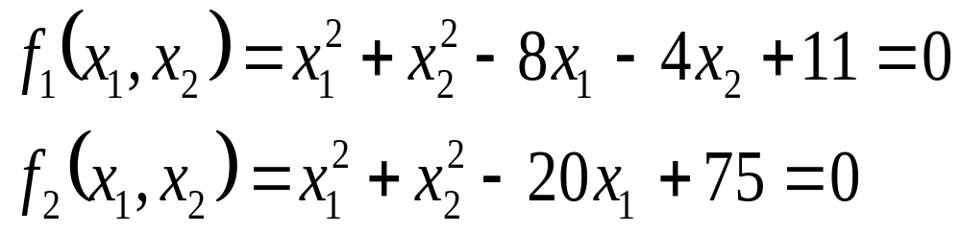
Systems of non-linear equations
Usually to solve a system of non-linear equations, we will use an extension of open methods.
An example of a system of non-linear equations is:

Slide 12
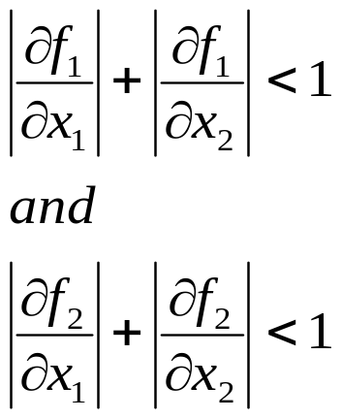
Fixed point iteration for systems of non-linear equations
One of the most important drawbacks of the fixed iteration method is that the convergence of the method is dependent on how the equations are formulated.
It can be shown that sufficient convergence criteria for two equations are:
This represents a very restrictive criteria and that’s why fixed point
iteration method is not used to solve systems of non-linear equations.

Slide 13
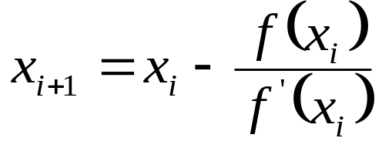
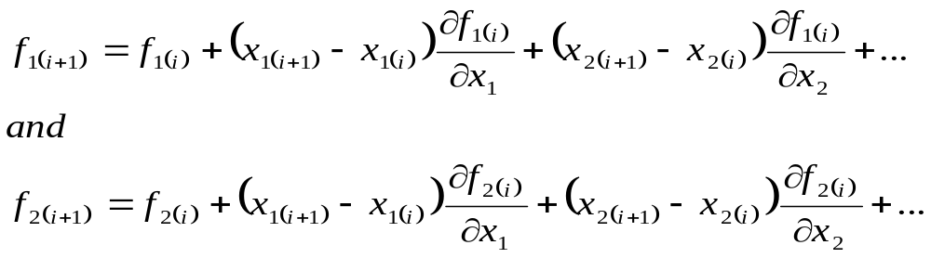
Newton-Raphson for systems of non-linear equations
The Newton-Raphson formula is the following:
considering a Taylor series that account for the presence of both variables
:

Slide 14
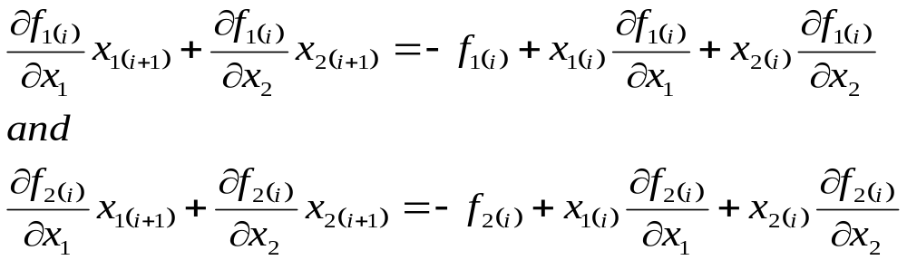
For the root estimate and must be equal zero. Therefore:

Slide 15
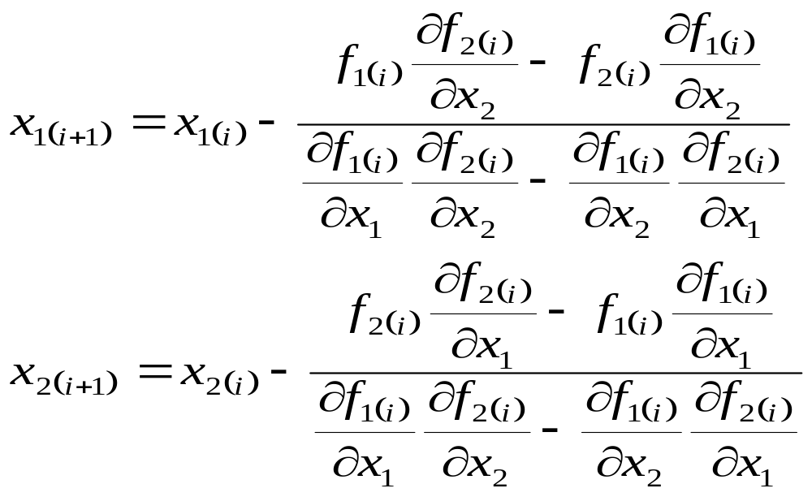
Finally;
The denominator is called the Jacobian.
These two equations are Newton-Raphson method for systems of non-linear equations.

Slide 16
Systems of Nonlinear Equations
Roots of a set of simultaneous equations:
f₁(x₁,x₂,…….,x_{n})=0
f₂ (x₁,x₂,…….,x_{n})=0
f_{n} (x₁,x₂,…….,x_{n})=0
The solution is a set of x values that simultaneously get the equations to zero.

Slide 17
Systems of Nonlinear Equations
Example: x² + xy = 10 & y + 3xy² = 57
u(x,y) = x²+ xy -10 = 0
v(x,y) = y+ 3xy² -57 = 0
The solution will be the value of x and y which makes u(x,y)=0 and v(x,y)=0
These are x=2 and y=3
Numerical methods used are extension of the open methods for solving single equation; Fixed point iteration and Newton-Raphson. (we will only discuss the Newton Raphson)

Slide 18
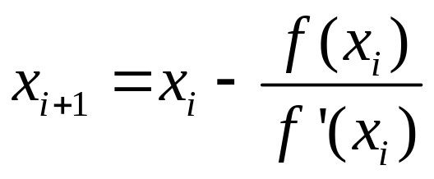
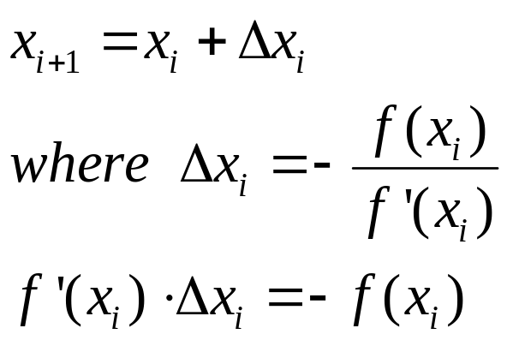
Systems of Nonlinear Equations:
2. Newton Raphson Method
Recall the standard Newton Raphson formula:
which can be written as the following formula

Slide 19
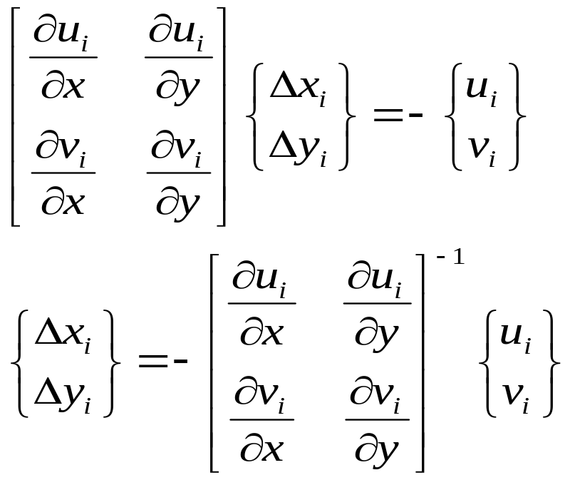
Systems of Nonlinear Equations:
2. Newton Raphson Method
By multi-equation version (in this section we deal only with two equation) the formula can be derived in an identical fashion:
u(x,y)=0 and v(x,y)=0

Slide 20
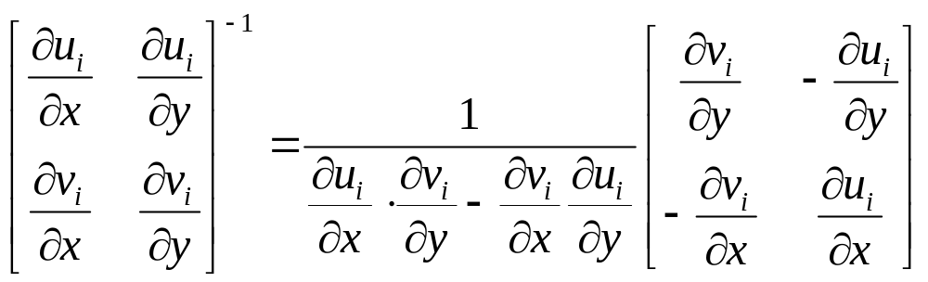
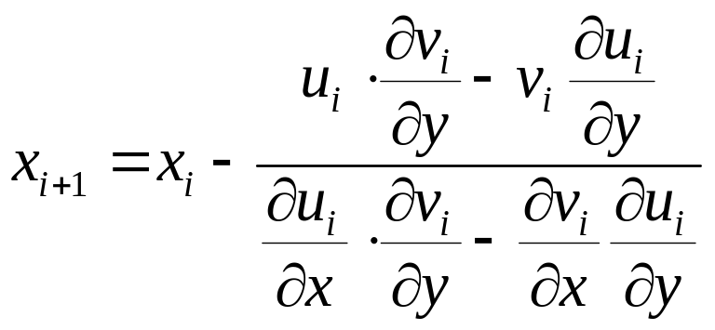
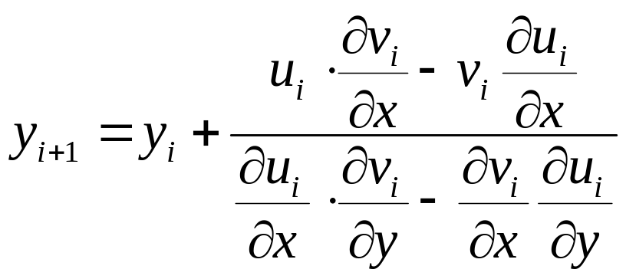
Systems of Nonlinear Equations:
2. Newton Raphson Method
And thus

Slide 21
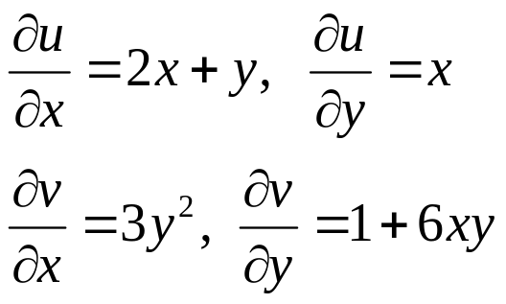
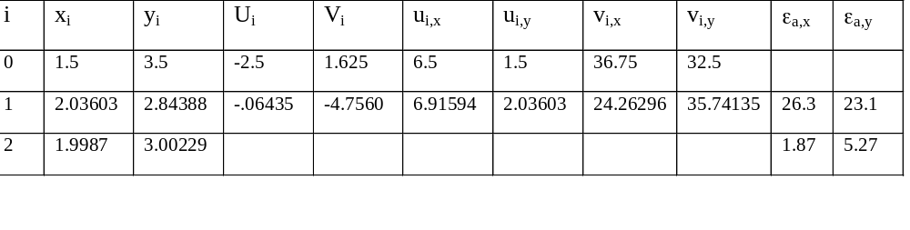
Systems of Nonlinear Equations:
2. Newton Raphson Method
x ²+ xy =10 and y + 3xy ² = 57
are two nonlinear simultaneous equations with two unknown x and y they can be expressed in the form: use the point (1.5,3.5) as initial guess.

